Slide 1
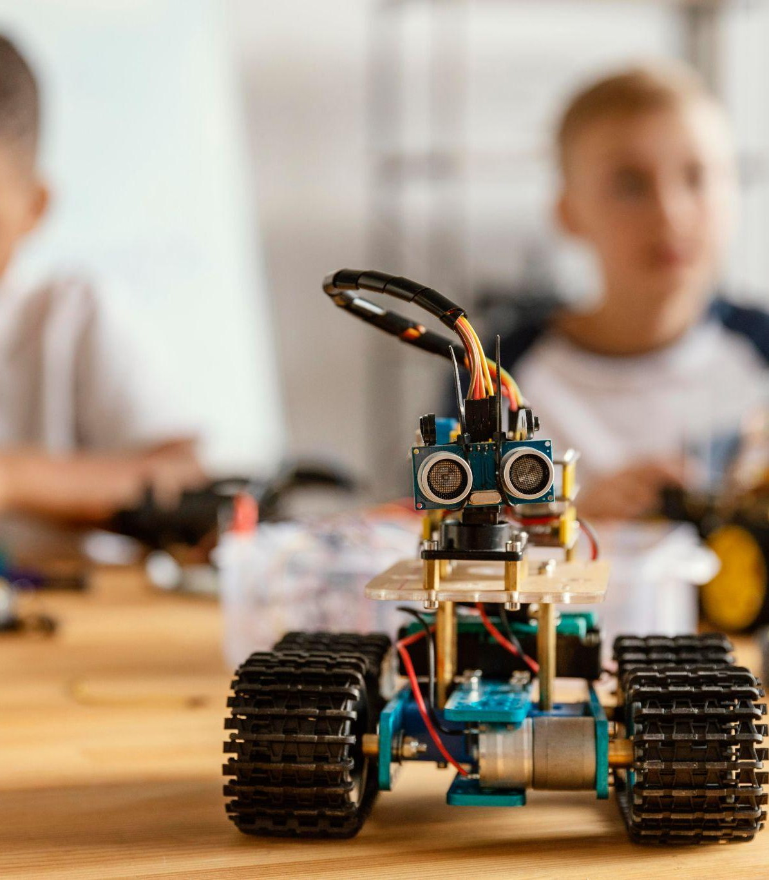
Robotic Application Development:
Smart Vacuum Cleaner Robot
Presented By,
                GAHDSE232F-001
                GAHDSE232F-002
                GAHDSE232F-003

Slide 2

Table of contents
01
02
03
04
Introduction
Used Technology &
Compornants
Objectives
Demonstration

Slide 3
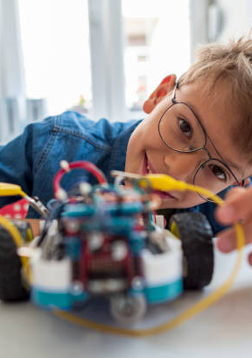
Introduction
01
Giving an explanation of the design, components, and functionality of the smart vacuum cleaner robot, highlighting its practicality for daily households.

Slide 4
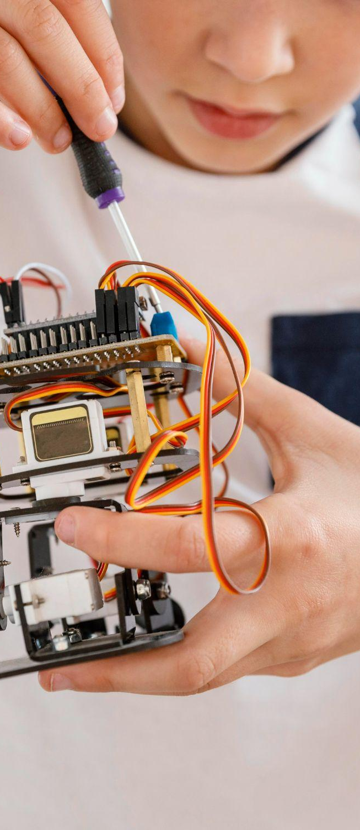
Used Technology & Components
02
Hardware
Technology

Slide 5

Objectives
03
Adapting to various floor surfaces
Optimizing cleaning mechanism
Reducing physical effort and cleaning time
Cost-Effectiveness
Ease of Use

Slide 6
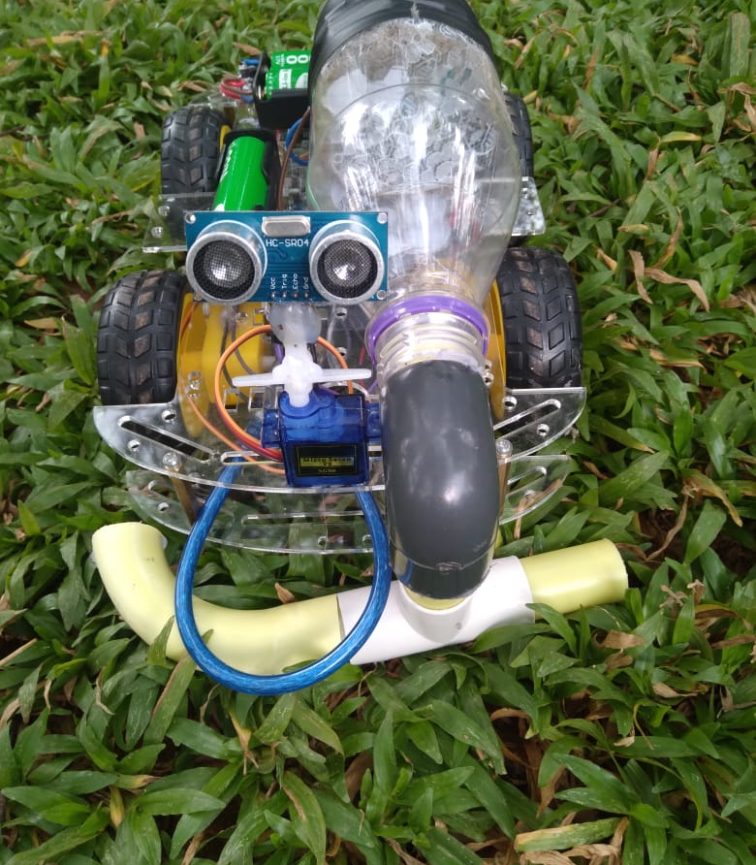
04
Demonstration

Slide 7

Thank You!

